Slide 1
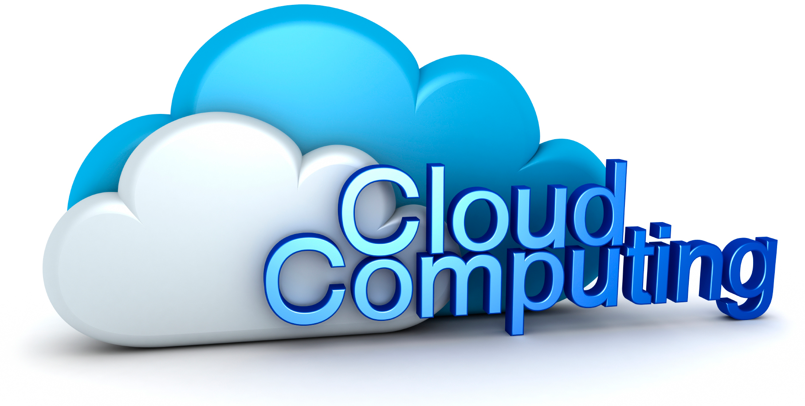
Created By :

Slide 2
Basic Questions
"What's the cloud?"
"Where is the cloud?"
"Are we in the cloud now?!"
These are all questions you've probably heard or even asked yourself. The term "cloud computing" is everywhere.

Slide 3
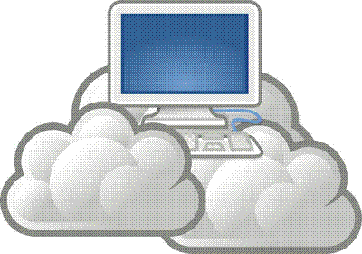
Definition
In the simplest terms, cloud computing means storing and accessing data and programs over the Internet instead of your computer's hard drive.
In computer networking, cloud computing is a phrase used to describe a variety of computing concepts that involve a large number of computers connected through a real-time communication network such as the Internet.

Slide 4
Why it is called Cloud
The cloud is just a metaphor for the Internet.
It goes back to the days of flowcharts and presentations that would
represent the gigantic server-farm infrastructure of the Internet as
nothing but a puffy, white cumulonimbus cloud, accepting connections
and doling out information as it floats.

Slide 5
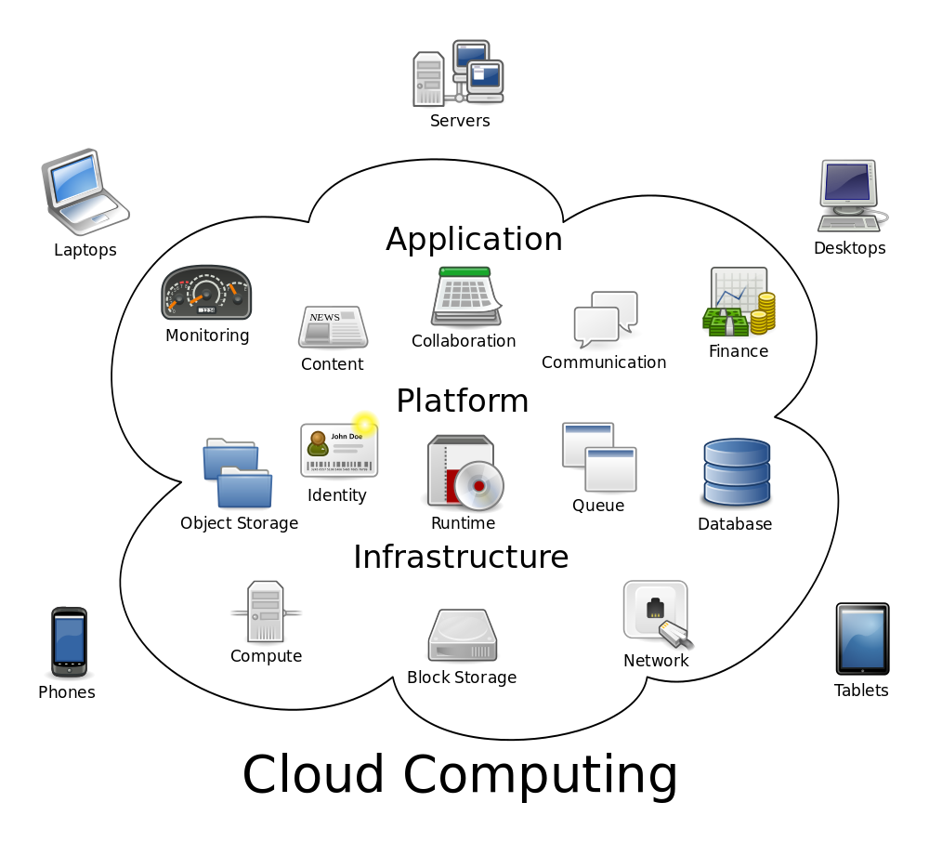

Slide 6
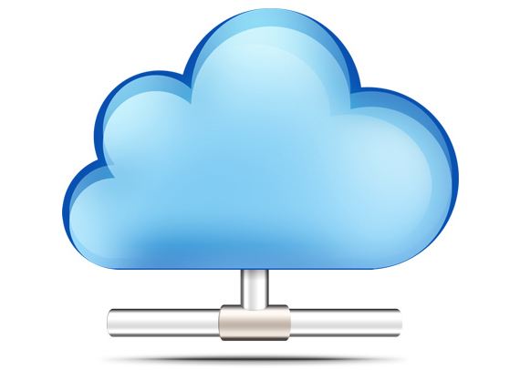
Cloud Computing Services
Cloud computing providers offer their services according to several fundamental models:
Software as a service (SaaS)
Platform as a service (PaaS)
Infrastructure as a service (IaaS)
where IaaS is the most basic and each higher model abstracts from the details of the lower models
In 2012, Network as a service (NaaS) and Communication as a service (CaaS) were officially included by ITU (International Telecommunication Union) as part of the basic cloud computing models.

Slide 7
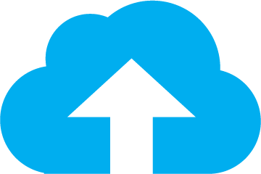
Infrastructure as a service (IaaS)
Infrastructure as a Service (IaaS) is a way to rent storage, hardware, servers and network capacity over the Internet.
The service provider owns massive computer resources and is responsible for running and maintaining them.
Meanwhile, the client needs only computer and Internet connection to access these bottomless resources and typically pays for it on a per-use basis.

Slide 8
Infrastructure as a service (IaaS)
The main features and components of Iaas are:
service-oriented utility computing,
automation of administrative tasks,
unlimited resources,
on demand self-service,
pay-per-use pricing,
desktop virtualization,
policy-based services.

Slide 9

Platform as a Service (PaaS)
Platform as a Service (PaaS) gives a possibility to run, create or test various applications by using provider's tools over the internet.
The consumer has no rights to manage or control the underlying cloud infrastructure (storage, servers, platforms, etc.), but is able to configure application hosting environment and the installed applications.

Slide 10
Advantages-PaaS
Advantages of using PaaS are:
possibility to change and upgrade the characteristics and components of operating system,
easier collaboration with specialist over the word,
opportunity to use resources that are over the national border without crossing it,
overall cost reduction by minimizing the expenses of hardware and programming tools, incompatibility problems and so on.

Slide 11
Disadvantages-PaaS
Disadvantages of using PaaS are:
some providers may not allow moving developed software out of his platform (security issues),
flexibility of this service may still be insufficient in meeting the needs of users, whose requirements are constantly changing.

Slide 12

Software as a Service (SaaS)
Software as a Service (SaaS) is a cloud computing model, which hosts various software applications and makes them available to customers over the Internet or other network.
There are two main software delivery models for SaaS:
to give an online access to a single copy of an application,
to host commercially available software and deliver it over Internet.

Slide 13
Advantages-SaaS
The main advantages of SaaS model are:
no concerns about software buying (licenses), installing and maintaining,
automatic updates and patch management,
automation of administrative tasks,
easier collaboration with other users – everyone has the same version of software,
world-wide access.

Slide 14
Disadvantages-SaaS
Disadvantages of SaaS (Software as a Service)
Security Issue: As data is stored on cloud, security becomes a major issue.
Latency Issue: Again as data is stored in cloud far away from end user, it may take more transactional time as compared to traditional approach.
Total Dependency on Internet: Relying on an Internet connection means that data is transferred to and from a SaaS firm at Internet speeds, rather than the potentially higher speeds of a firm’s internal network.
Switching between SaaS vendors is difficult: Switching SaaS vendors may involve the slow and difficult task of transferring very large data files over the Internet.

Slide 15
Infrastructure
(as a Service)
Platform
(as a Service)
Software
(as a Service)
Applications
Runtimes
Security & Integration
Databases
Servers
Virtualization
Server HW
Storage
Networking
You Manage
Applications
Runtimes
Security & Integration
Databases
Servers
Virtualization
Server HW
Storage
Networking
Applications
Runtimes
Security & Integration
Databases
Servers
Virtualization
Server HW
Storage
Networking
You Manage
Managed By Vendors
Managed By Vendors
Managed By Vendors

Slide 16
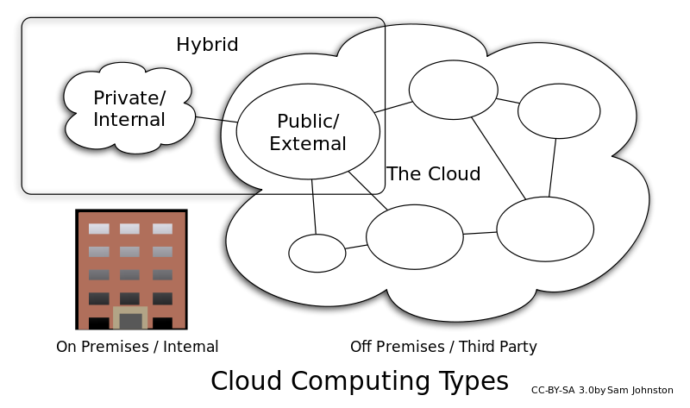
Deployment models
Controlled Cloud
Public Cloud
Private Cloud.
Community Cloud
Hybrid Cloud

Slide 17
Controlled cloud
Controlled cloud services are not publicly available; users are specifically authorized by services vendors.
Access to the controlled cloud may be through the Internet; however, connections would be encrypted.
The cloud vendor employs various techniques and technologies to prevent unauthorized access.
Use of services is governed by contracts, and service-level agreements which specify the responsibilities of the vendor and the responsibilities of the customer with regard to data stewardship.

Slide 18
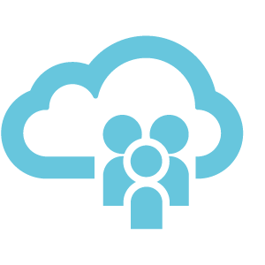
Public Cloud
A public cloud is a standard cloud computing model wherein a service provider manages storage and computing resources on behalf of consumer over the Internet.
Public clouds are run by third parties, and applications from different users are shared on the provider’s cloud servers, storage systems, and networks.
Benefits of public clouds include ease of on-demand scalability as they are larger than a company’s private cloud.
Security Concern:
Shared resources are major target of attack for hackers.
target of a Denial of Service (DoS) attack.
e.g.- Amazon Elastic Compute Cloud (EC2), IBM's Blue Cloud, Sun Cloud, Google AppEngine and Windows Azure Services Platform.

Slide 19

Private Cloud
also called internal cloud or corporate cloud
typically hosted on customer premises
provides hosted services to authorized users behind a company firewall
company has control over resources, data, security and QoS.
The company owns the infrastructure and controls how applications are deployed on it.
Benefits of going with private cloud is increased control and monitoring of resources, flexibility of customization, ability to recover from failure, and the ability to scale up or down depending upon demand.
Attracted criticism because users "still have to buy, build, and manage them" and thus do not benefit from less hands-on management

Slide 20
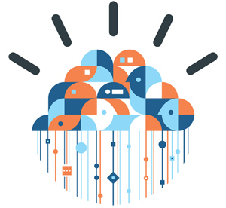
Community Cloud
Community cloud shares infrastructure between several organizations from a specific community with common concerns (security, compliance, jurisdiction, etc.), whether managed internally or by a third-party and hosted internally or externally.
The costs are spread over fewer users than a public cloud (but more than a private cloud), so only some of the cost savings potential of cloud computing are realized.

Slide 21
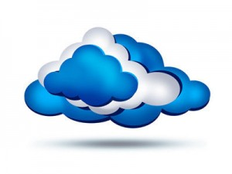
Hybrid Cloud
composition of two or more clouds (private, community or public)
remain unique entities but are bound together
offering the benefits of multiple deployment models
ability to connect collocation, managed and/or dedicated services with cloud resources
Companies able to obtain degrees of fault tolerance combined with locally immediate usability without dependency on internet connectivity.
It requires both on-premises resources and off-site (remote) server-based cloud infrastructure.

Slide 22
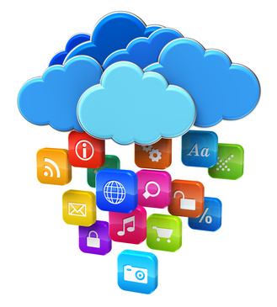
Cloud Bursting
It is an application deployment model in which an application runs in a private cloud or data center and "bursts" to a public cloud when the demand for computing capacity increases.
A primary advantage of cloud bursting and a hybrid cloud model is that an organization only pays for extra compute resources when they are needed.
Cloud bursting enables data centers to create an in-house IT infrastructure that supports average workloads, and use cloud resources from public or private clouds, during spikes in processing demands

Slide 23
Cloud Computing Sample Architecture
Cloud Service
(eg Queue)
Cloud Platform
(e.g Web Front)
Cloud Infrastructure
(eg Billing VMs)
Cloud Storage
(Database)

Slide 24
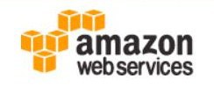





Cloud Service Providers
Amazon Web Services
Google
Microsoft
Rackspace
JustCloud
SugarSync
SpiderOak

Slide 25

Advantages of Cloud Computing
Cost – Transform Capital Expenditure for servers into and operating expenses
Multi-tenancy – Several customer share the shame infrastructure
Scalability – “On-demand” provisioning of Computing resources
Redundancy – Redundancy of sites is easier to implement
Accessibility – Device and Location independence
Maintenance – Upgrades are applied centrally and done by IT experts

Slide 26
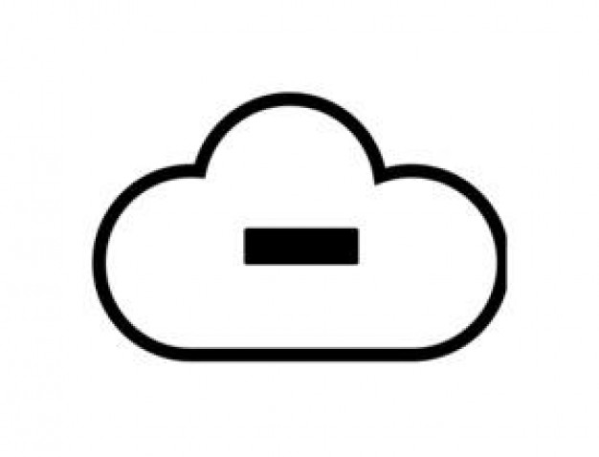
Disadvantages of Cloud Computing
Security – Loss of control oversensitive data
Dependency – Tied to you Cloud Service Provider
Flexibility – Special customization of computing resources may not be possible
Cost – Cost structure is becoming opaque
Knowledge – Most of the knowledge is concentrated at the cloud service Provider
Integration – Difficult Integration with other equipment and systems

Slide 27
Conclusion
For it to be considered "cloud computing," you need to access your data or your programs over the Internet, or at the very least, have that data synchronized with other information over the Net.
With an online connection, cloud computing can be done anywhere, anytime.
Like everything else, cloud computing too has its pros and cons. While the technology can prove to be a great asset to your company, it could also cause harm if not understood and used properly.

Slide 28
References
http://www.pcmag.com/article2/0,2817,2372165,00.asp
http://mobiledevices.about.com/od/additionalresources/a/Cloud-Computing-Is-It-Really-All-That-Beneficial.htm
http://www.wikinvest.com/concept/Cloud_Computing
http://sbinfocanada.about.com/od/itmanagement/a/Cloud-Computing-Disadvantages.htm
http://en.wikipedia.org/wiki/Cloud_computing

Slide 29


